Slide 1
SUB-CONVOLUTIONAL VASNet BASED SPEECH ENHANCEMENT

Slide 2
ABSTRACT
INTRODUCTION
OBJECTIVES
BENEFITS OF COMMUNITY PEOPLE
PROBLEM STATEMENT
LITERATURE SURVEY
SOFTWARE/HARDWARE COMPONENTS
SYSTEM DESIGN/ALGORITHM
REAL TIME DEMONSTRATION
WORK DONE SO FAR
RESULTS IF ANY
REFERENCES
TABLE OF CONTENTS:

Slide 3
ABSTRACT:
Sub-Convolutional VAS-Enet, a novel architecture designed for speech enhancement tasks. Traditional convolutional neural networks (CNNs) have demonstrated considerable success in this domain, but they often require large amounts of data and computational resources.
To address these challenges, our approach leverages sub-convolutional layers, which are capable of capturing fine-grained spectral and temporal features with reduced complexity.
By integrating these layers into a variational autoencoder-based Speech Enhancement Network (VAS-Enet), we achieve a more efficient and accurate model.

Slide 4
INTRODUCTION
Speech signal in a real world environment is degraded by background noise that reduces its intelligibility and quality for human listeners.
It can further degrade the performance of speech based applications speech enhancement aims at improving the intelligibility and quality of speech signal by removing background noise.
Single channel speech enhancement in low signal-to-noise ratio(SNR) conditions is considered a very challenging problem
Speech enhancement has been extensively studied in recent years as a supervised learning problem using deep neural networks(DNNs)
Supervised approaches to speech enhancement generally convert a speech signal to a time-frequency representation and extract input features and training targets from it.

Slide 5
PROBLEM STATEMENT
"Sub-Convolutional VAS-Net Based Speech Enhancement Using Voice Activity Detection and Causal Spatial Attention," addresses this challenge by developing a novel approach that integrates advanced neural network architectures with innovative techniques in voice activity detection and causal spatial attention. The goal is to significantly enhance speech quality by accurately isolating and amplifying speech signals while suppressing background noise, even in real-time scenarios.
By leveraging the strengths of Sub-Convolutional VAS-Net, which excels in capturing complex speech patterns, and incorporating voice activity detection for precise speech segment identification, our model aims to deliver superior speech enhancement performance. Additionally, the use of causal spatial attention ensures the model's effectiveness in dynamic and noisy environments, making it a robust solution for a wide range of real-world applications.
Current speech enhancement techniques often struggle to effectively distinguish speech from background noise, leading to degraded audio quality and reduced intelligibility. This problem is particularly critical in applications such as teleconferencing, hearing aids, and voice-controlled devices, where clear and accurate speech is essential.

Slide 6
OBJECTIVES:
1.Noise Reduction: Reduce additive noise, such as background chatter or ambient noise.
2. Improved Speech Intelligibility: Enhance speech quality to improve understanding.
3.Reverberation reduction: Reduce reverberation effects, such as echo or echo-like effects.
4.Speech dereverberation: Remove reverberation effects from speech signals.
5.Audio restoration: Restore degraded audio signals.
6.Speech separation: Separate speech from background noise.

Slide 7
LITERATURE SURVEY:
Author | Journal name | Title | Methodology | Description | Year
D. Crystal | IEEE/ACM Transactions on Audio, Speech, and Language Processing | "Speech Enhancement Using Attention-based Convolutional Neural Networks" | Introduces a convolutional neural network (CNN) enhanced with an attention mechanism to focus on important speech features. | how attention-based mechanisms can improve speech enhancement tasks by filtering noise and irrelevant information. | 2008
Katrin Lichterfeld | IEEE Transactions on Neural Networks and Learning Systems | "Make your voice heard and tune your ears for a global orchestra”. | Combines sub-convolutional layers with recurrent neural networks (RNNs) to model time dependencies in speech data. | The paper focuses on real-time speech enhancement, addressing both stationary and non-stationary noise environments. | 2021

Slide 8
Author | Journal name | Title | Methodology | Description | Year
Damien Pollard | IEEE/ACM Transactions on Audio, Speech, and Language Processing | End-to-End Waveform Speech Enhancement Using Generative Adversarial Networks" | Proposes a GAN-based model for enhancing speech directly from the waveform, without explicit feature extraction. | This research illustrates the potential of GANs in generating high-quality enhanced speech in noisy conditions. | 2021
ANDREA LEVITT, MARGERY LUCAS | Computer Speech & Language | “EFFECTS OF FOUR VOICE QUALITIES AND FORMANT DISPERSION ON PERCEPTION" | Reviews various deep learning architectures (e.g., CNNs, RNNs, attention networks) for speech enhancement in noisy environments. | The paper provides an overview of different deep learning methods, emphasizing robust speech enhancement in challenging acoustic conditions. | 2018

Slide 9
SOFTWARE/HARDWARE COMPONENTS
SOFTWARE:
Google colab,
Python Version:3.8
Opearating system : Windows

Slide 10
Proposed Methodology:
The goal of this methodology is to develop a speech enhancement system using a Sub-Convolutional Variational Autoencoder-based Network (VAS-Enet). This system aims to improve the quality of speech signals corrupted by noise, focusing on maintaining high performance while reducing computational complexity. The methodology leverages the strengths of variational autoencoders (VAEs) for learning robust latent representations of clean speech and integrates sub-pixel convolutional layers to enhance the resolution of speech features efficiently.

Slide 11
SYSTEM IMPLEMENTATION:
For the implementation of Sub-Convolutional VasNet for Speech Enhancement, the chief coding language would be Python based on the library picked in such deep learning frameworks like TensorFlow or PyTorch when building and training the neural network model. The audio processing pipeline is expected to use Librosa while loading and preparing the audio data by converting noisy and clean audio to spectrograms, preferably through STFT or Melspectrogram. These include NumPy and SciPy to execute signal processing operations and a library called Sound file for reading and writing audio files. Indeed, the VasNet architecture is the sub-convolutional one and basically is the combination of a CNN that is being used to decompose the input signal into frequency sub-bands and then each of those sub-band signals are processed individually and then combined together to produce the cleaned signal. With backpropagation, all models are trained on clean and noisy speech pairs with the loss function set as mean squared error. For all the models, their performance is measured using SNR and PESQ while the enhanced audio is saved via Librosa but for model analysis and tuning, it would show results like spectrograms and curves by loss using tools like Matplotlib.

Slide 12
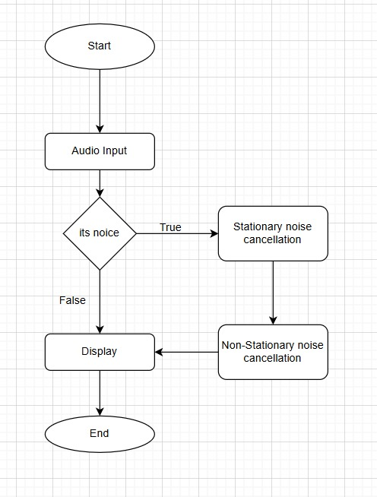
BLOCK DIAGRAM:

Slide 13
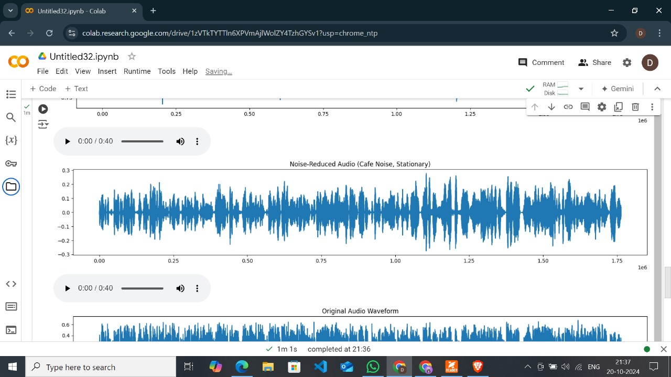
RESULTS AND DISCUSSIONS:

Slide 14
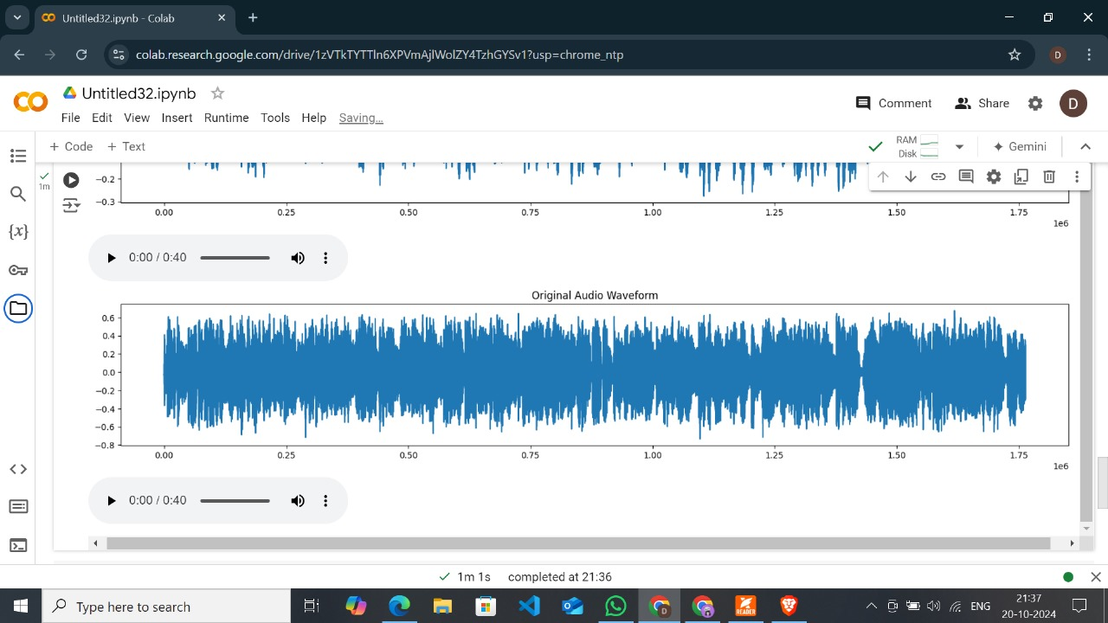
RESULTS AND DISCUSSIONS:

Slide 15
COMMUNITY IMPACT:
Community people can benefit from Sub-Convolutional VasNet based speech enhancement in various ways:
Improved Communication:
Enhanced speech intelligibility: Sub-Convolutional VasNet improves speech quality, making it easier for individuals with hearing impairments or those in noisy environments to understand conversations.
Better phone call clarity: Enhanced speech quality improves phone call communication, enabling clearer conversations and reduced misunderstandings.
Healthcare Benefits:
Improved telemedicine: Enhanced speech quality facilitates remote healthcare consultations, ensuring accurate communication between patients and healthcare professionals.
Enhanced medical transcription: Sub-Convolutional VasNet-based speech enhancement improves automated transcription accuracy, reducing errors in medical records.

Slide 16
COMMUNITY IMPACT:
Education and Learning:
Enhanced online learning: Improved speech quality in online courses and video lectures facilitates better understanding and engagement.
Increased accessibility: Sub-Convolutional VasNet-based speech enhancement enables students with hearing impairments to fully participate in online learning.
Better language learning: Enhanced speech quality aids language learners in understanding pronunciation and intonation.
Social Benefits:
Increased social connections: Improved communication enables individuals to connect with others more effectively, reducing feelings of isolation.
Enhanced community engagement: Sub-Convolutional VasNet-based speech enhancement facilitates community participation, promoting social inclusion.
Better customer service: Enhanced speech quality improves customer service interactions, leading to increased satisfaction.

Slide 17
CONCLUSION:
The work introduces a novel approach to speech enhancement (SE) using a Convolutional Spatial Attention (CSA) block and a Voice Activity Detection (VAD)-assisted multi-task learning framework. A two-branch network is designed to handle SE and VAD tasks concurrently, with joint optimization improving SE performance. The CSA block enhances feature extraction, ensuring real-time SE. The TANSCU Net model incorporates innovative techniques like sub-convolutional encoders, demonstrating the importance of local and global contextual information in speech. The VSA Net, integrating these advancements, achieves better real-time SE despite its modest size. Future research aims to explore more potent multitask learning schemes and extend techniques to other areas like speech dereverberation and separation.

Slide 18
Reference
[1.author name:D. Crystal ] https://www.math.chalmers.se/~ulfp/Review/crystal.pdf
[2.author name:Katrin Lochtefeld] https://real.mtak.hu/140281/7/Proceedings_with%20DOIs_6-15.pdf
[3.author name:ANDREA LEVITT, MARGERY LUCAS] https://intapi.sciendo.com/pdf/10.2478/plc-2018-0018
[4.author name:Damien Pollard] https://api.repository.cam.ac.uk/server/api/core/bitstreams/675ef2c0-e1ec-4a10-9de2-cd121d1baf44/content
[5.author name:Anne Karpf] https://repository.londonmet.ac.uk/1276/1/Anne%20Karpf%20IMAGO%5B37436%5D.pdf

Slide 19
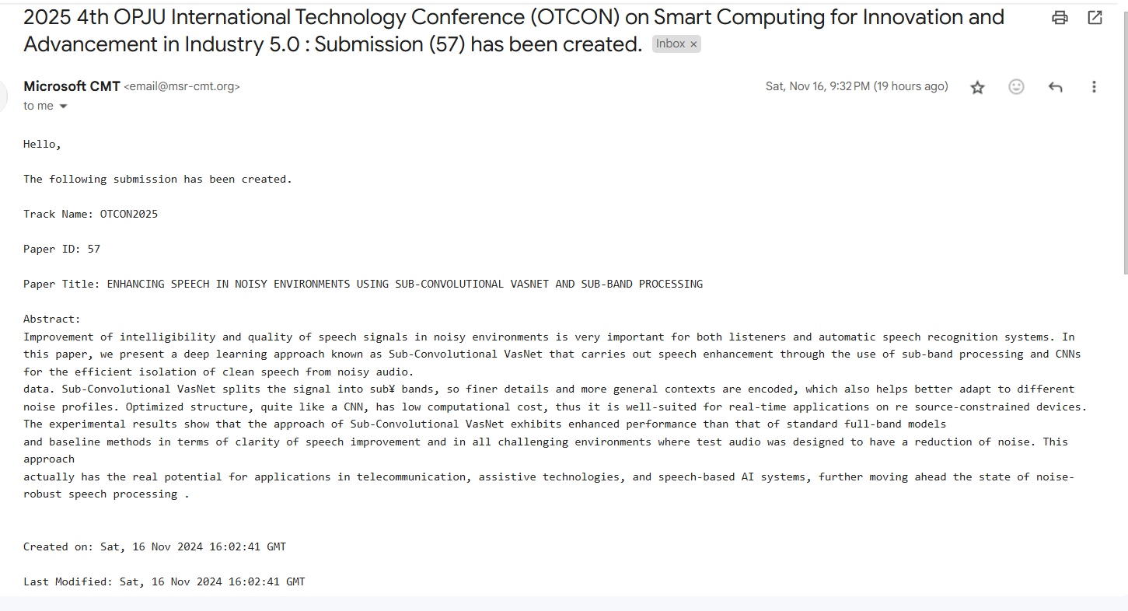
PROOF OF PAPER SUBMISSION:

Slide 20
THANK YOU

